Slide 1

Figures

Slide 2
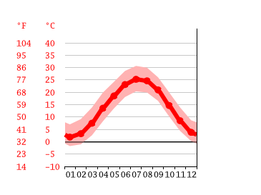
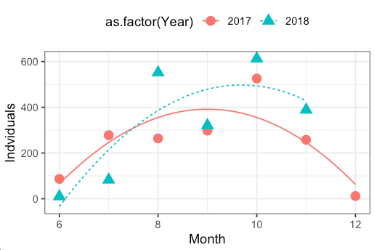


Seasonal selection does not occur in a vacuum
Fruit fly
generations in a year
Collection Year
40
Mean Temperature (℃)
0
Summer/Fall
Boom
-10
Jan
Dec
Month
Spring
Expansion
Winter
Collapse
Notes:
A second insight, which is not genomic, but rather demographic in nature.
Particularly, the idea that, when we think of seasonality, these temperature selection regimes do not occur in the vacuum,
Instead, we have observed that seasonal oscillation also have a demographic component. Particularly, fly populations tend to achieve their maximum population size in the peak of the harvest season, when resources are abundant. However, as the winter rolls in, resources become scares and fly populations collapse.
This effective produces a coupled system where thermal selection co-occurs with demographic cycles of expansion and collapse

Slide 3
Figure 1

Slide 4
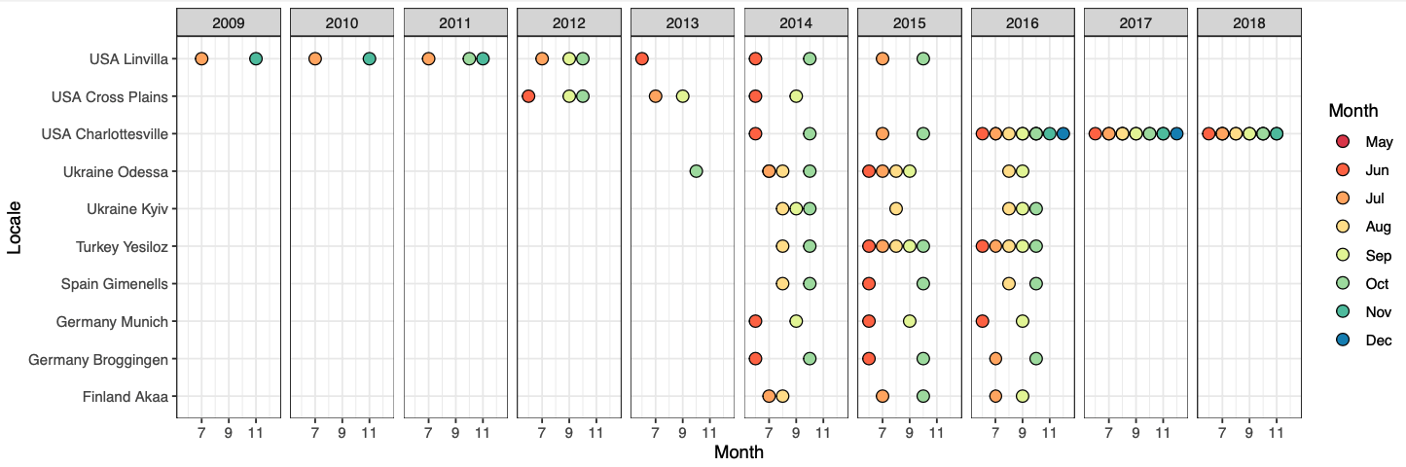

Slide 5
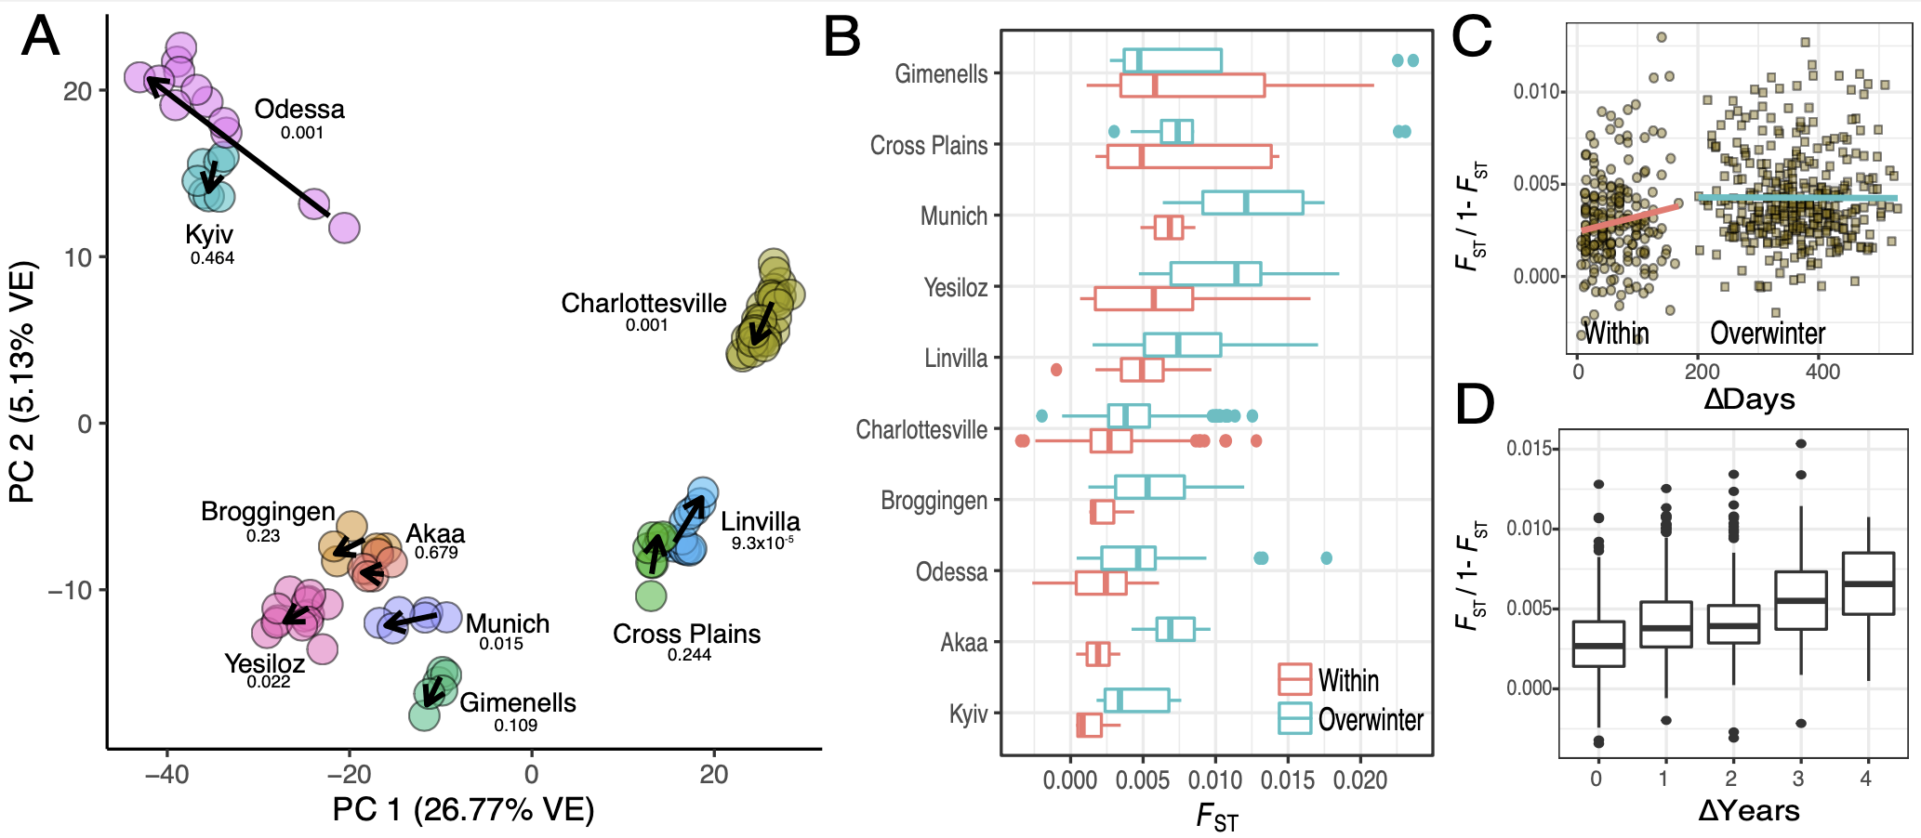
Notes:
Figure 1:

Slide 6
Figure 2

Slide 7
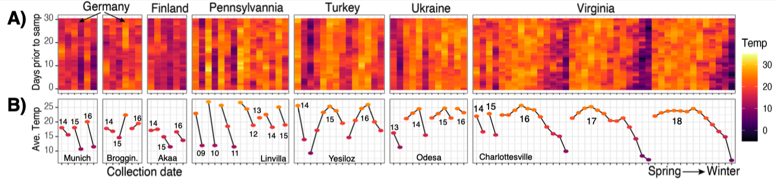

Slide 8
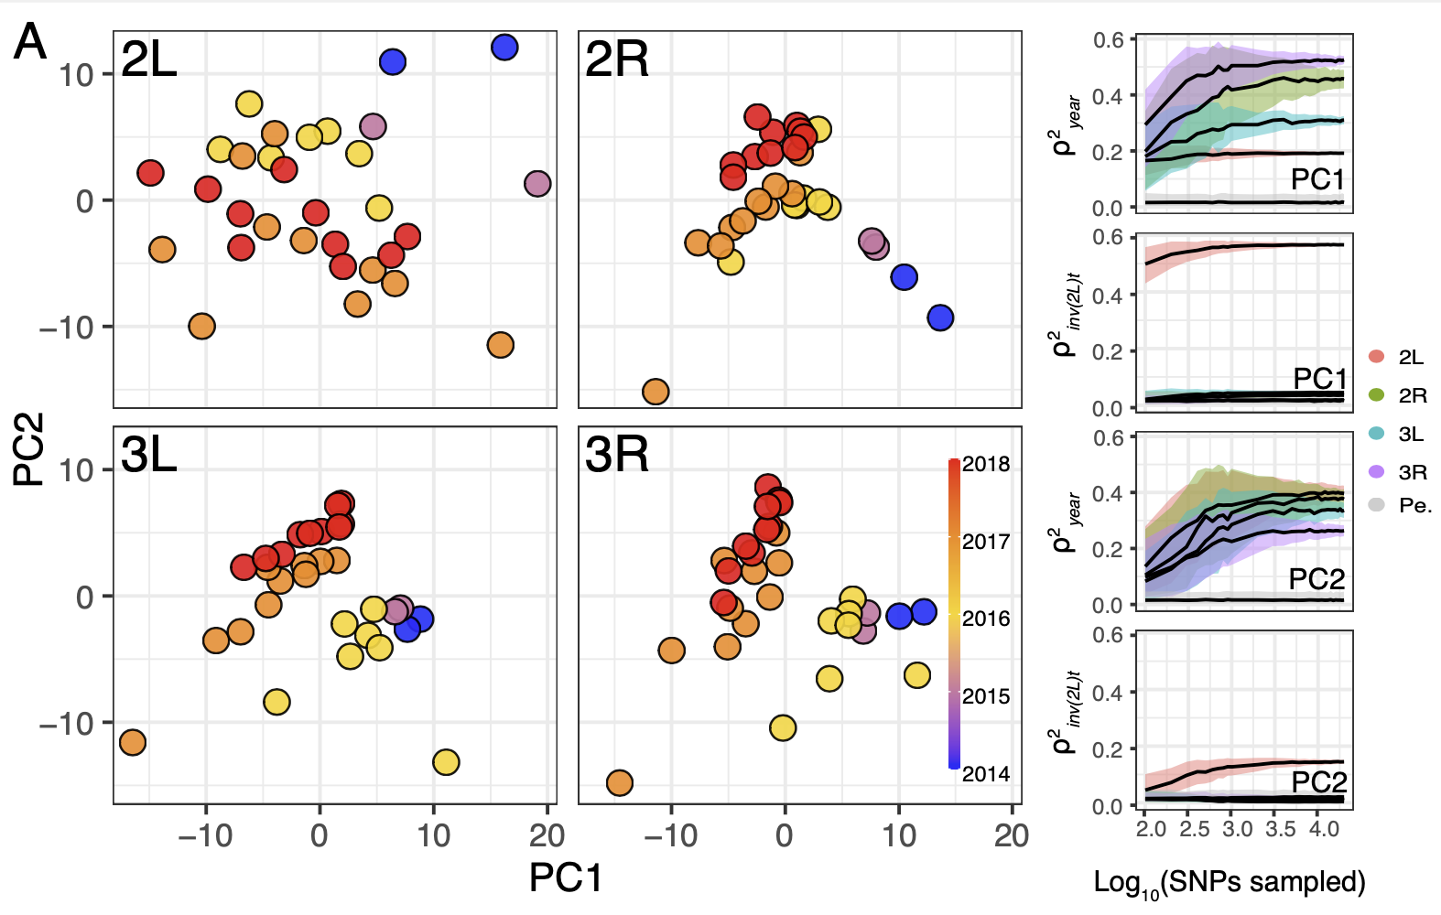

Slide 9
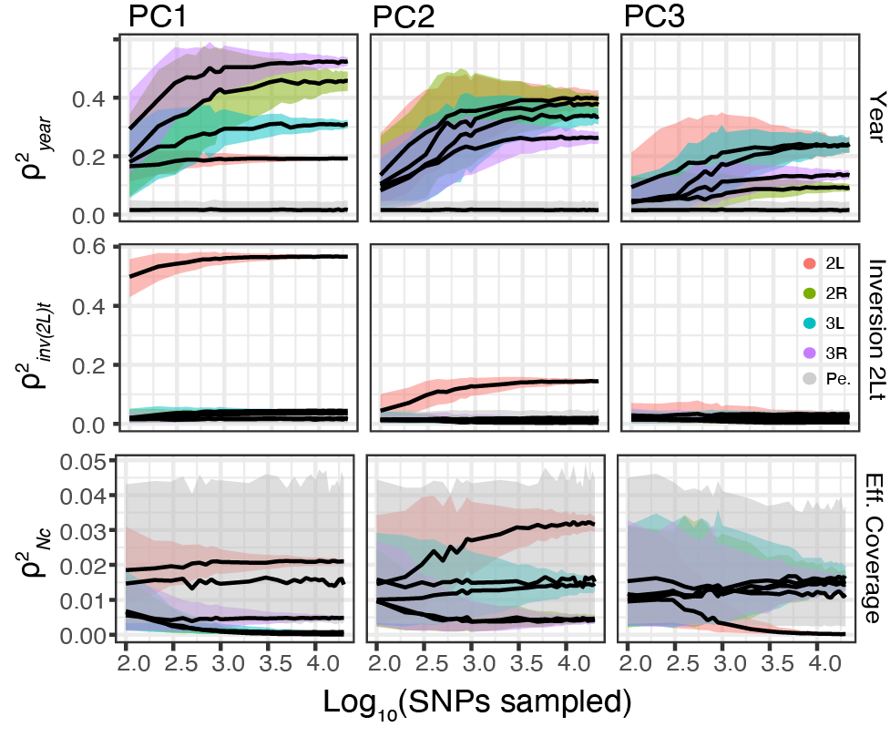

Slide 10
Figure 3

Slide 11
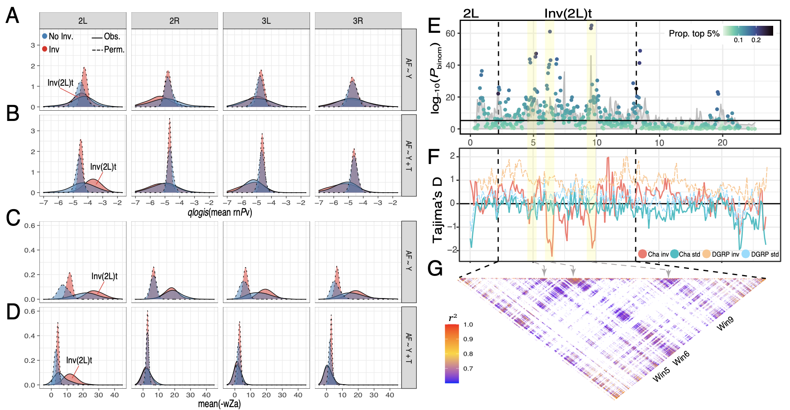

Slide 12
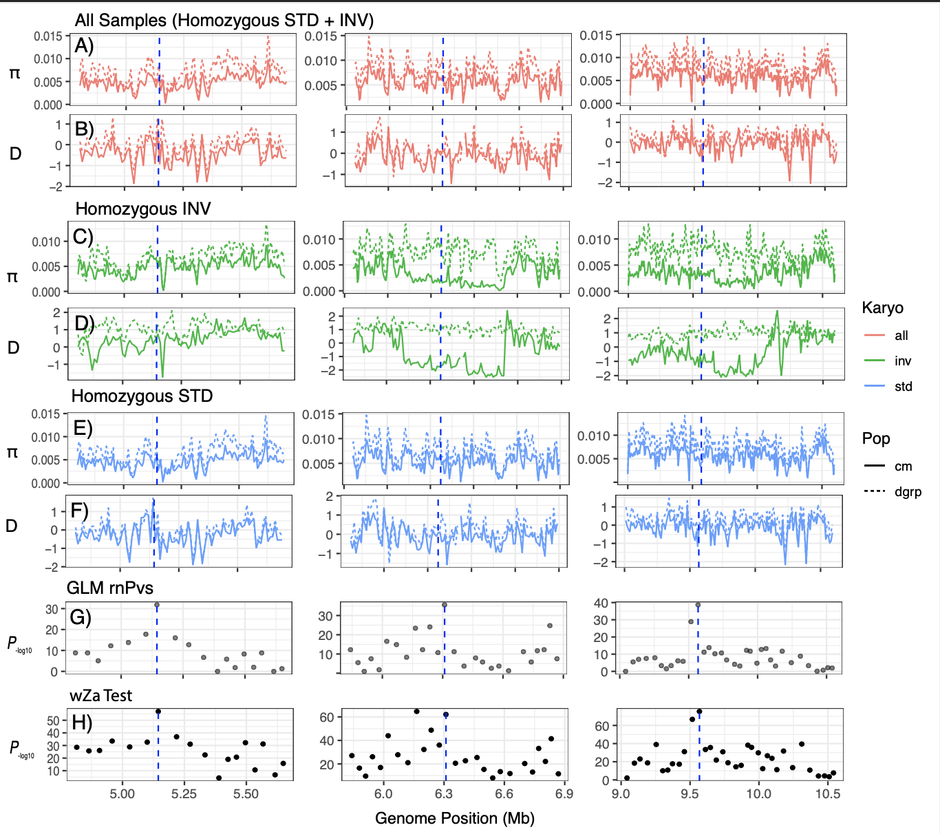

Slide 13
Figure 4

Slide 14
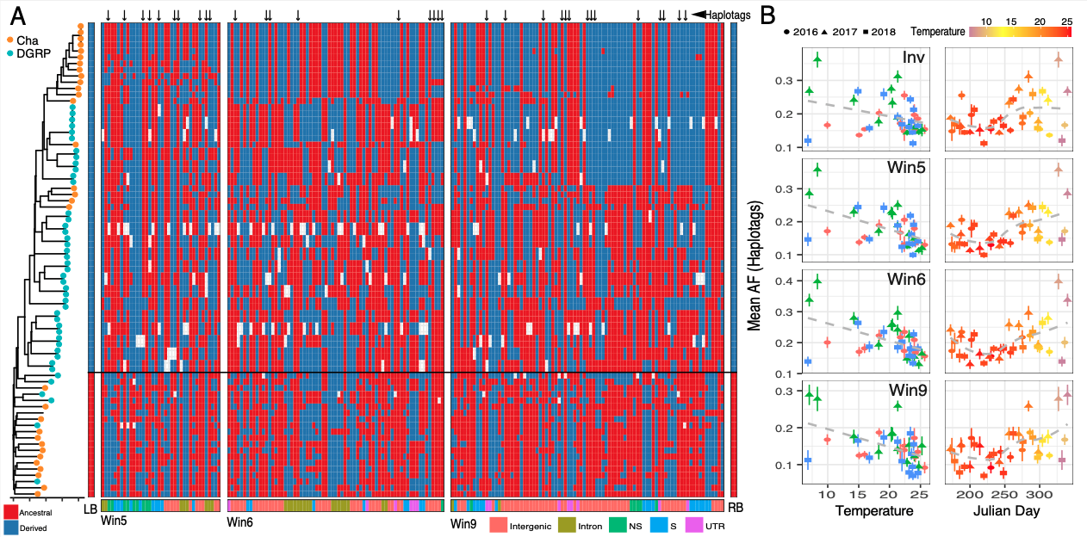

Slide 15
Methodological Figures

Slide 16
